Slide 1
AI Based Diabetes Prediction System
MACHINE LEARNING

Slide 2
INTRODUCTION
AI in Healthcare is an industry that always makes it necessary to make a precise decision, whether it is a treatment, test, or discharge.
Diabetes is common due to modern food intake, and it is necessary to keep track of the body. AI in Diabetes helps to predict or Detect Diabetes.
Any neglect in health can have a high cost for the patients and the medical practitioner. It becomes challenging for the patient to trust that this decision is taken by the machine that does not explain how it reaches a particular conclusion.

Slide 3
Do WE NEED IN HEALTHCARE
Data: It explains the data used for the prediction, their correlation, and EDA (Exploratory Data Analysis) to understand the hidden data patterns. It tells how the data is to be used for the AI system.
Algorithm: A complete transparency of the system's algorithm is given with the reason why the system chooses it and how it can be beneficial for the prediction.
Model: Akira AI gives a detailed explanation of model performance and working in a user-friendly manner.
Output: Akira AI gives a complete justification for the system's output with the reason. It also provides the factors that contribute to influence the result of the system.

Slide 4
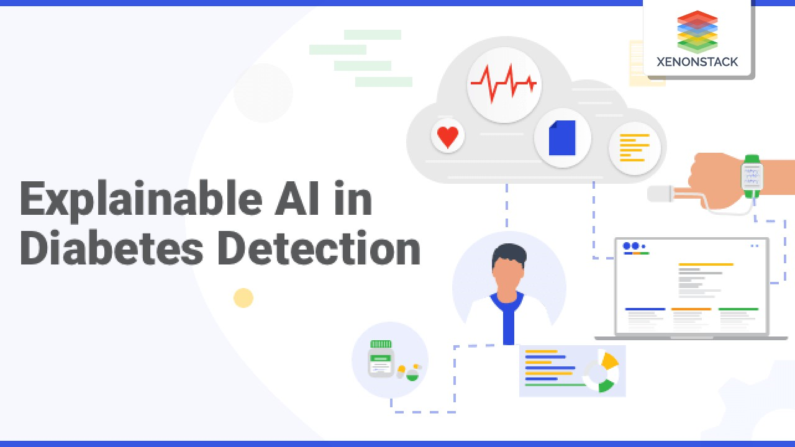

Slide 5
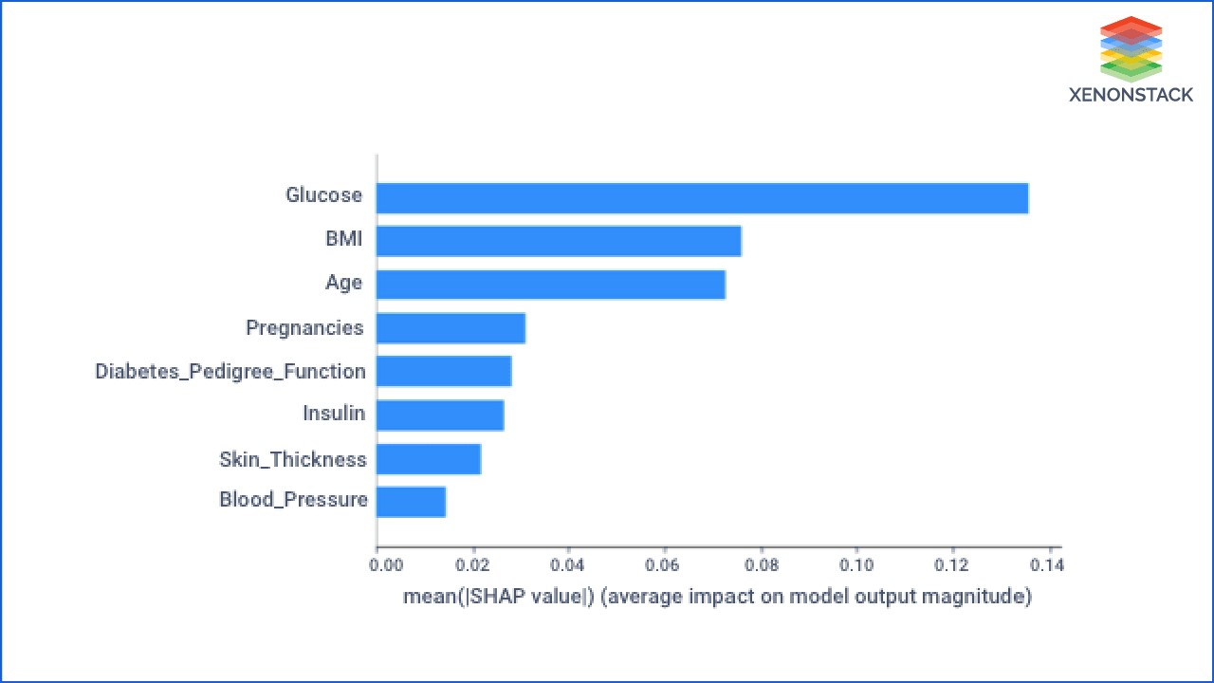

Slide 6
ALGORITHM
There is a step by step approach to implementing AI in Diabetes detection. From selecting data to the deploying system, Akira AI has methodologies and framework that can be implemented for providing the Explanation, such as
STEPS
Selection of the right data and preprocess it for the model.
Precisely select the suitable algorithm for the system.
Use various frameworks to make the model working transparent.
Justify the model output and factors on which it depends.
To use a clear and clean deployment process.

Slide 7
COMPARSION
ADVANTAGES
DISADVANTAGES
Accuracy is improved using deep learning.
Reduced cost of care.
Interactive application in which user can given a single input to arrive the prediction.
Better patient care.
Real-time,accurate data.
Training complication.
Inaccuracies could occur.
Social variable may not be considered.
Increase security risk.
Still requires human input.
Risk of creating unemployment.

